Slide 1
Chapter 21: Principal Component Analysis
Textbook: Ahmad Daryanto, Introduction to Quantitative Research Methods for Marketing With SPSS and R: Tools and Techniques, Routledge. 2024

Slide 2
Learning Objectives
Understand the basic principles of Principal Component Analysis (PCA).
Able to use SPSS and R to conduct PCA.
Know how to interpret the PCA outputs.
Understand the principle of PCA from a geometric perspective.

Slide 3
Principal Component Analysis
Goal: To reduce and summarize data into a smaller set of dimensions
The newly created dimensions/variables are called principal components.

Slide 4
Principle Component Analysis (PCA) – conceptual structure
V₁
PC₁
V₄
V₅
PC2
V₁₀
PC = Principal component
The direction of the arrows are from observed variables to PCs

Slide 5
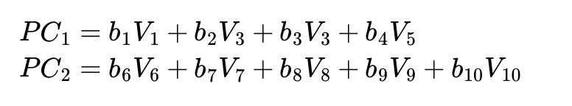
PCA
Each principal component (PC) extract maximum variation (variance) from the data.
The first PC extracts the most variance and the last PC extract the least variance, i.e.., Var (PC1 )> Var (PC2), and so on.
Principal component is the weighted linear combination of observed variables (i.e.., V1, …,V10) – just like in regression.
Sum of squares of the coefficients = 1, to prevent the variable to be extremely large to infinity.
The correlation between PCs are zero, i.e., each PC is not correlated with the other.

Slide 6
Principle Component Analysis (PCA) – conceptual structure
b₁
V₁
PC₁
b₄
V₄
V₅
b₅
PC2
b₁₀
V₁₀
PC = Principal component
The direction of the arrows are from observed variables to PCs

Slide 7
Principle Component Analysis (PCA) – loadings
0.869
V₁
PC₂
0.869
V₂
V₃
0.841
PC₁
0.887
V₄
0.893
V₅
PC = Principal component
The direction of the arrows are from observed variables to PCs

Slide 8
Hypothetical example (PCA)
In PCA, the correlation matrix
Is used with value ‘1’ in the main diagonal
Correlation matrix
V₁ V₂ V₃ V₄ V₅ V₁ 1
V₂ .5 1 V₃ 0.1 0.1 1 V₄ 0.1 0.1 .6 1 V₅ 0.1 0.1 .6 .7 1
Can you already see how the five variables can be reduced into a smaller set of dimensions?

Slide 9
PCA – using SPSS syntax
MATRIX DATA
VARIABLES=ROWTYPE_ V1 V2 V3 V4 V5.
BEGIN DATA.
N 500 500 500 500 500
COR 1.000
COR .520 1.000
COR .109 .107 1.000
COR .110 .109 .609 1.000
COR .113 .111 .623 .722 1.000
END DATA.
FACTOR
/MATRIX=IN(COR=*)
/ANALYSIS V1 V2 V3 V4 V5
/EXTRACTION PC
/PLOT EIGEN
/ROTATION VARIMAX.
PC indicates that PCA is requested
If you replace it with PAF, the principal axis factoring
will be used, which is an EFA technique.

Slide 10
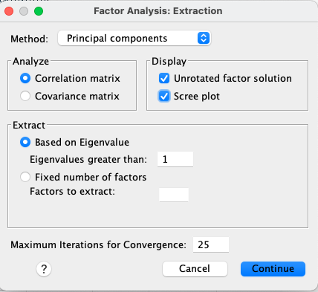

Slide 11
Is it appropriate to use PCA?
To make sure that there is enough correlation in the data to justify using PCA for dimension reduction, the Bartlett’s sphericity test is used.
H0: The variables are mutually independent (PCA is inappropriate)
HA: The variables are not mutually independent (PCA is appropriate)
In our example, because p<0.05, H0 is rejected, therefore PCA is justified.

Slide 12
KMO-criterion
KMO-Criterion for the evaluation of the correlation matrix as a whole:
KMO ≥ 0.9 “excellent“
KMO ≥ 0.8 “deserving“
KMO ≥ 0.7 “quite good“
KMO ≥ 0.6 “moderate“
KMO ≥ 0.5 “miserable“
KMO < 0.5 “unbearable”
Thus, according to Kaiser, the threshold is 0.5
Cerny, C.A., & Kaiser, H.F. (1977). A study of a measure of sampling adequacy for factor-analytic correlation matrices. Multivariate Behavioral Research, 12(1), 43-47.
Kaiser, H. 1974. An index of factor simplicity. Psychometrika 39: 31–36.

Slide 13
How many components should be retained?
Kaiser’s rule
Scree plot
Horn’s parallel analysis

Slide 14
Kaiser’s rule
Developed in 1959 by Kaiser.
Rule: retain only principal components with eigen values greater than 1.
Eigen value=variance of the principal component
If all the original variables (V1,..V5) are uncorrelated (full decomposition), then each variables are principal components with eigen value equal to 1.
So the rule stated that it is common sense that the principle component should account for variance greater than 1—as much variation as any one of the original variables.
Very subjective, should only use as a guideline.

Slide 15
Scree plot
Here is the ‘elbow’ at component, from which, the line declines in a linear fashion. Two components can be retained.
Principal Component

Slide 16
Horn’s parallel analysis
Horn’s parallel analysis is based on a comparison of eigenvalues obtained from sample data to eigenvalues one would expect to obtain from completely random data.
Horn.spd is the click-and-click SPSS macro
Download here:
https://sites.google.com/site/ahmaddaryanto/scripts/horn-s-parallel-analysis
Install the macro via ‘custom builder dialog’.
Extensions→Utilities-->Customer Dialog Builder.
After being installed, the macro can be found by clicking:
Analyze→Dimension Reduction→Horn’s Parallel Analysis

Slide 17
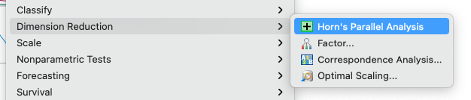
Horn’s parallel analysis

Slide 18
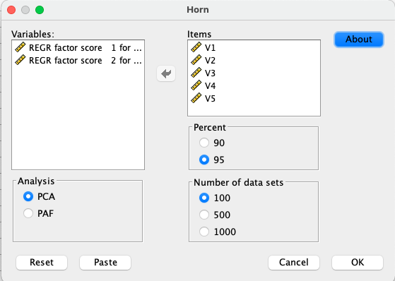

Slide 19
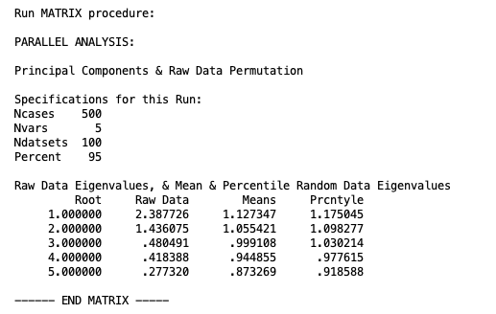
Specifications for random data generation. 100 data sets were generated each having 500 cases and 5 variables. 95th percentile of eigen values distributions is set.
95th percentile of eigen values of random data distribution
Mean eigen values of random data
Eigen values of actual data

Slide 20
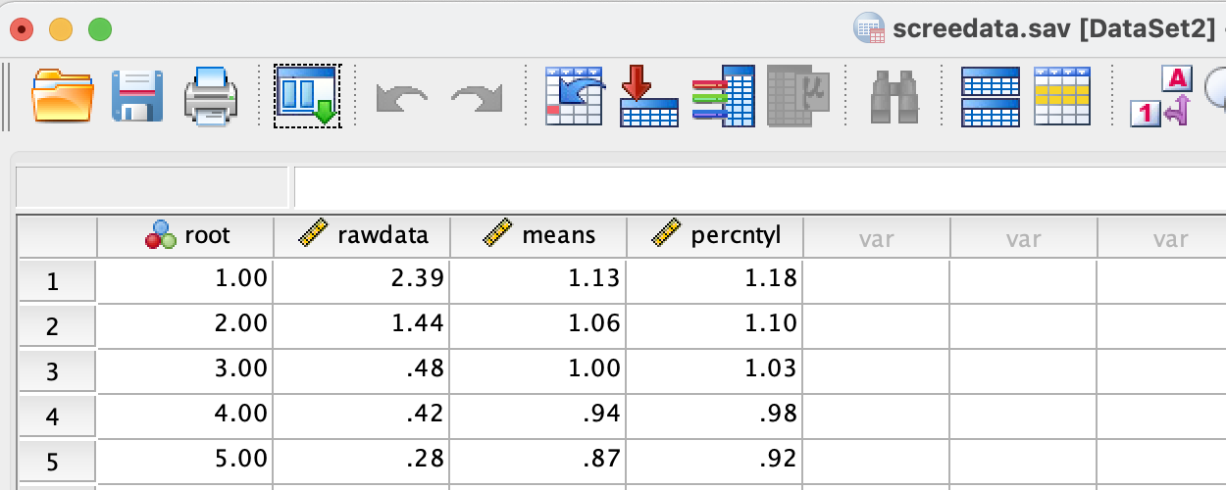

Slide 21
Look at eigenvalues that are greater than the 95th percentile eigenvalues expected from random data
The scree plot and the 95th percentile line crossed at a point between component 2 and 3. At component 2, eigen values of the actual data is greater than those of random data. Therefore, 2 components are retained.
Principal Component

Slide 22
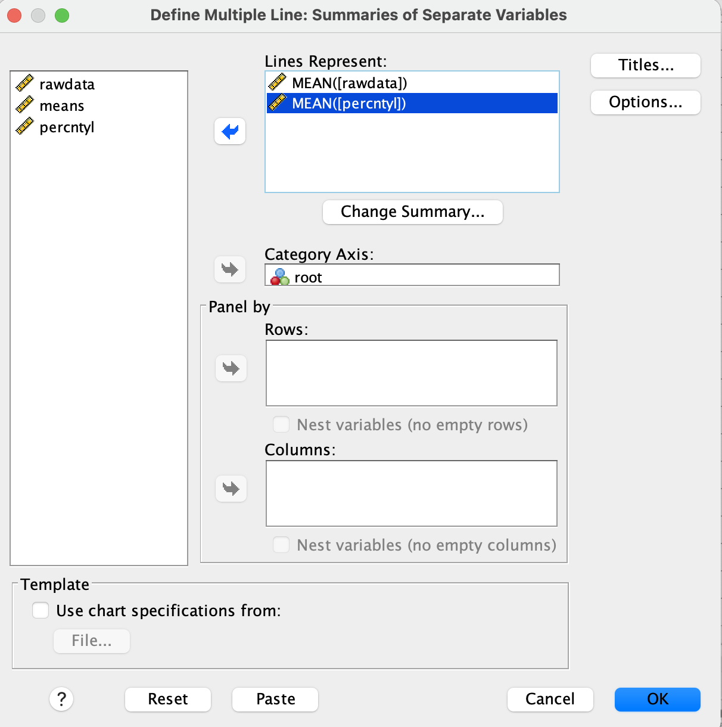

Slide 23
Scree plot of raw data and ‘means’

Slide 24
Rotated Component matrix (PCA)
Component loadings = Correlation between a variable and principal components
A clear structure
Components are rotated for easier interpretations.
Rotations change the correlation but
communalities are unchanged.
Communalities for v1 = 0.064² + 0,869² = 0.76

Slide 25
Loadings below 0.4 are not shown.

Slide 26
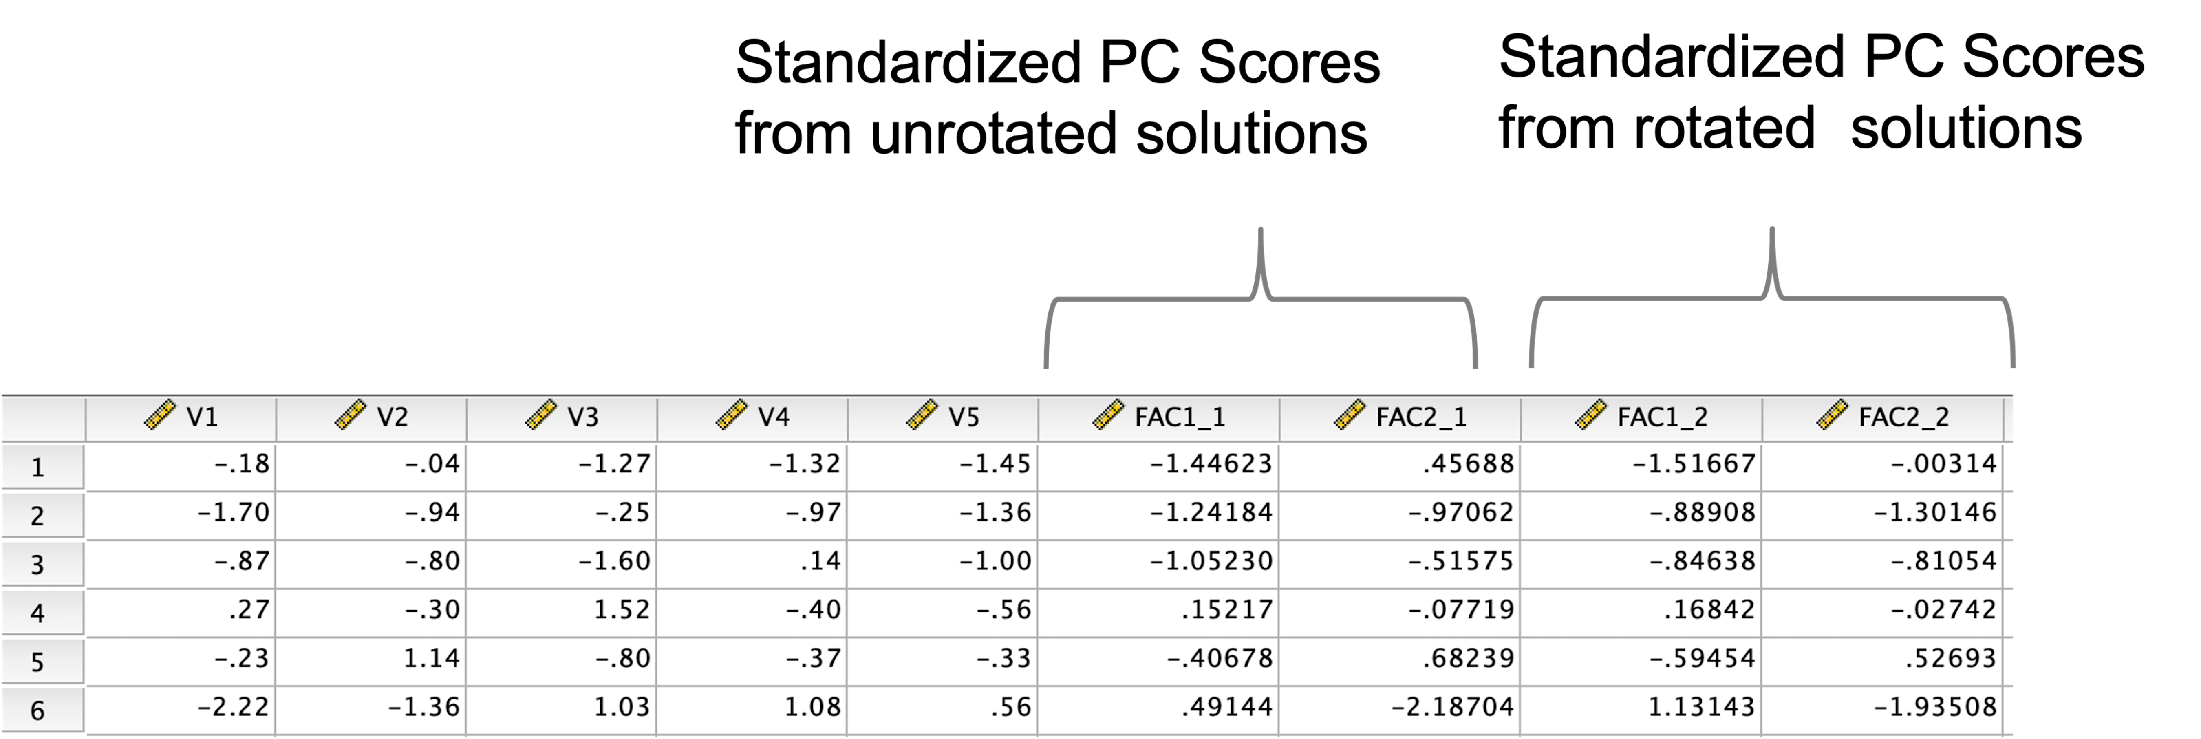
Component score (PCA)

Slide 27
Component score
These correlations are the loadings of V1 on PC1 and PC2

Slide 28
Total variance explained (PCA)
Value in the box shows the total variance explained by PC1 and PC2, which is 76.5%.
= 2.387/total eigen values
= (2.387/5)*100% = 47.749%
Part 1
Part 2
Part 3
Proportion of variance accounted for by two PCs before rotation
Proportion of variance accounted for by two PCs after rotation
Using a correlation matrix as an input, the total variance is the total number of original variables = 5.

Slide 29
= 2.3/total eigen values
= (2.3/5)*100% = 46%
Proportion of variance accounted for
by two PCs after rotation (76.48%)

Slide 30
SPSS point-and-click procedure
SPSS: Analyze→Dimension Reduction→Factor • Click: Extraction→Principal component analysis • Click: Rotation: Varimax or oblique
Varimax assumed the PCs are NOT correlated
Oblique assumes the PCS are correlated
Click: Scores
Tick ‘Save variables’ to save PCs into your data
Tick ‘ Display score pattern coefficient matrix’ to output the ’weights’ or component scores that are used to calculate PCs
Note: the ‘weights’ are not loadings. Loadings are correlation between observed variables and PCs

Slide 31
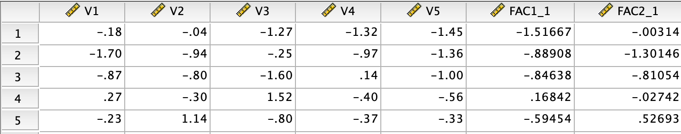
Standardized PC Scores from rotated solutions

Slide 32
Loadings below 0.4 are not shown

Slide 33
Key issues in PCA
Is there enough correlations among variables in the data?
How many dimensions/principal components will be retained?
What are appropriate name for the principal components?
How would you use the newly created variables (ie principal components) for further analysis?

Slide 34
PCA in R
prcomp() function
PCA() function
principal() function

Slide 35
prcomp() function
library(haven)
rm(list=ls()) # start from a clean slate.
dat <- read_sav("/Users/ahmaddaryanto/Documents/Data1/fake_data_for_pca.sav")
res <- prcomp(dat, center=TRUE, scale=TRUE) # based on correlation matrix
summary(res)
eigen_val <- res$sdev^2 # variance of the pcs
print(round(eigen_val,3))
eigen_val <- res$sdev^2 # variance of the pcs
print(round(eigen_val,3))
var_explained = round((eigen_val / sum(eigen_val)) * 100,2)
print(var_explained)
ncomp <-2 # number of components
eigen_vec <- res$rotation[ ,1:ncomp] # eigen vector
sd_pc <- diag(res$sdev,ncomp,ncomp)
loadings <- eigen_vec %*% sd_pc
print(loadings) # SPSS loadings
round(t(loadings[,1]) %*% loadings[,1],6)

Slide 36
PCA() Function
# Load the necessary librarie(s)
library(haven) # to read an SPSS data
library(FactoMineR)
dat <- read_sav("/Users/ahmaddaryanto/Documents/Data1/fake_data_for_pca.sav")
res <- PCA(dat, graph = FALSE)
print(res)
eigen <- res$eig
print(eigen)
install.packages("factoextra")
library(factoextra)
p <- fviz_screeplot(res, addlabels = TRUE,
geom ="line", ncp = 5) +
theme_classic()
p

Slide 37
# Setting addlabels = TRUE, shows eigen values.
# geom ="line" requests a line graph.
# ncp is the number of component to display.
# The output is a ggplot()'s style graph.
ncomp <- 2 # number of components
loadings <- res$var$cor[,1:ncomp]
print(loadings)
# standardized all variables in the data
zdat <- scale(dat, center=TRUE, scale=TRUE)
pc <- zdat %*% loadings # principal component scores.
zpc <- scale(pc, center=TRUE, scale=TRUE)
## Print top rows of the variable
print(head(zpc))
fsc <- res$ind$coord[, 1:ncomp]
print(head(fsc))

Slide 38
principal() function
rm(list=ls())
library(haven)
library(psych)
dat <- read_sav("/Users/ahmaddaryanto/Documents/Data1/fake_data_for_pca.sav")
res <- principal(dat, nfactors=5, rotate="none")
# print rest
print(res)
ncomp <- 2 # number of components to retain
new_res <- principal(dat, nfactors= ncomp)
print(new_res)
loadings <- res$loadings
print(loadings)
zpc <-new_res$scores
head(zpc)

Slide 39
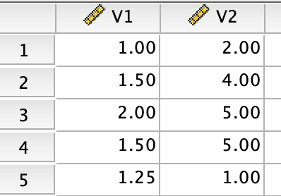
Geometric Perspective

Slide 40
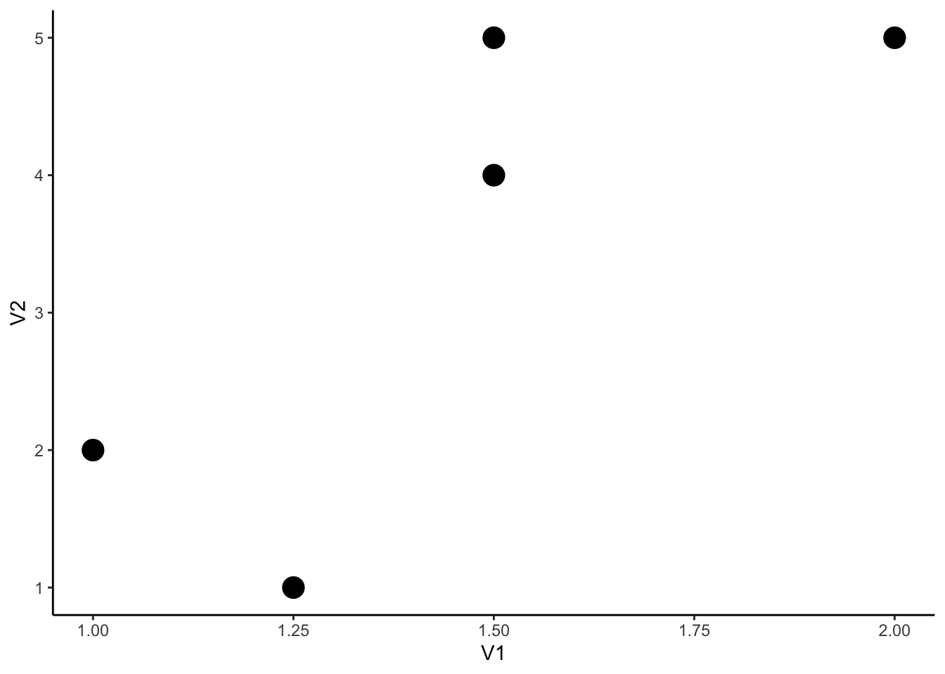

Slide 41
PC

Slide 42
PC
1
5
2
4
3
Origin

Slide 43
PCA Solutions of the mini data

Slide 44
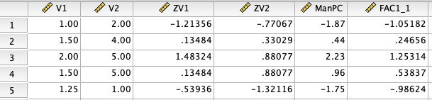
Standardized PC scores from SPSS
PC scores calculated by hands
Standardized variables

Slide 45
library(haven)
library(FactoMineR)
dat <- read_sav("/Users/ahmaddaryanto/Documents/Data1/pca_mini_data.sav")
res <- PCA(dat, graph = FALSE)
eigen <- res$eig
print(eigen)
loadings <- res$var$cor[,1:2]
print(loadings[,1])
PC1 <- res.pca$ind$coord[,1]
PC1

Slide 46
Further Readings
Farley, J. U. (1964). Why does "brand loyalty" vary over products?. *Journal of Marketing Research*, 1(4), 9-14..
Holbrook, M. B., & Batra, R. (1987). Assessing the role of emotions as mediators of consumer responses to advertising. *Journal of Consumer Research*, 14(3), 404-420.
Holbrook, M. B. (1993). Gratitudes and latitudes in MBA attitudes: customer orientation and the business week poll. *Marketing Letters*, 4, 267-278.

